Slide 1
Operating System Concept Map
A.7

Slide 2
Overview
Pick an Operating System
From Appendix A
Work Individually
Step 1: Research Your Operating System
For each of the required topics
See Student Handout for Topics
Step: 2: Create a Concept Map
Use application of your choice
Use the template as a starting point
Due: Wednesday, Dec 11
Be prepared to present part of your concept map
Upload research to and map to GitHub

Slide 3
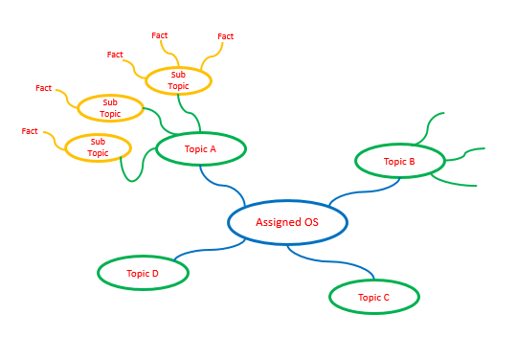
Concept Map Template
Note: Replace placeholder names with your actual assigned OS and research topics.

